Slide 1
Supervised approach to Machine Learning

Slide 2
Supervised Learning
Supervised learning is the types of machine learning in which machines are trained using well "labelled" training data, and on basis of that data, machines predict the output. The labelled data means some input data is already tagged with the correct output.
In supervised learning, the training data provided to the machines work as the supervisor that teaches the machines to predict the output correctly. It applies the same concept as a student learns in the supervision of the teacher.
Supervised learning is a process of providing input data as well as correct output data to the machine learning model. The aim of a supervised learning algorithm is to find a mapping function to map the input variable(x) with the output variable(y).

Slide 3
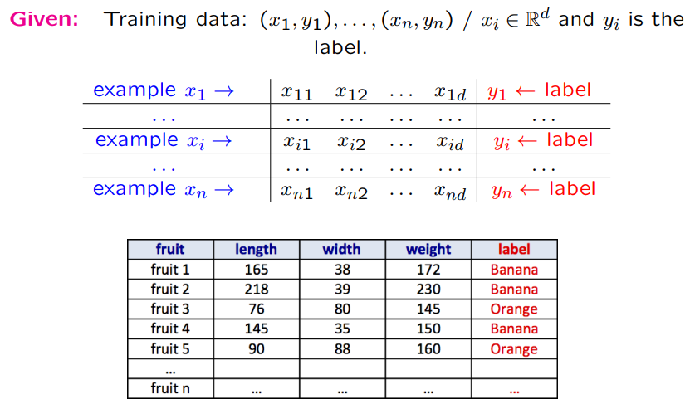
Supervised Learning

Slide 4
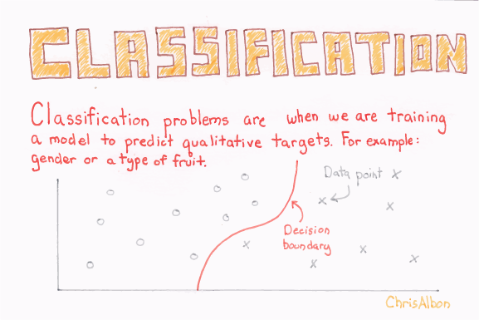
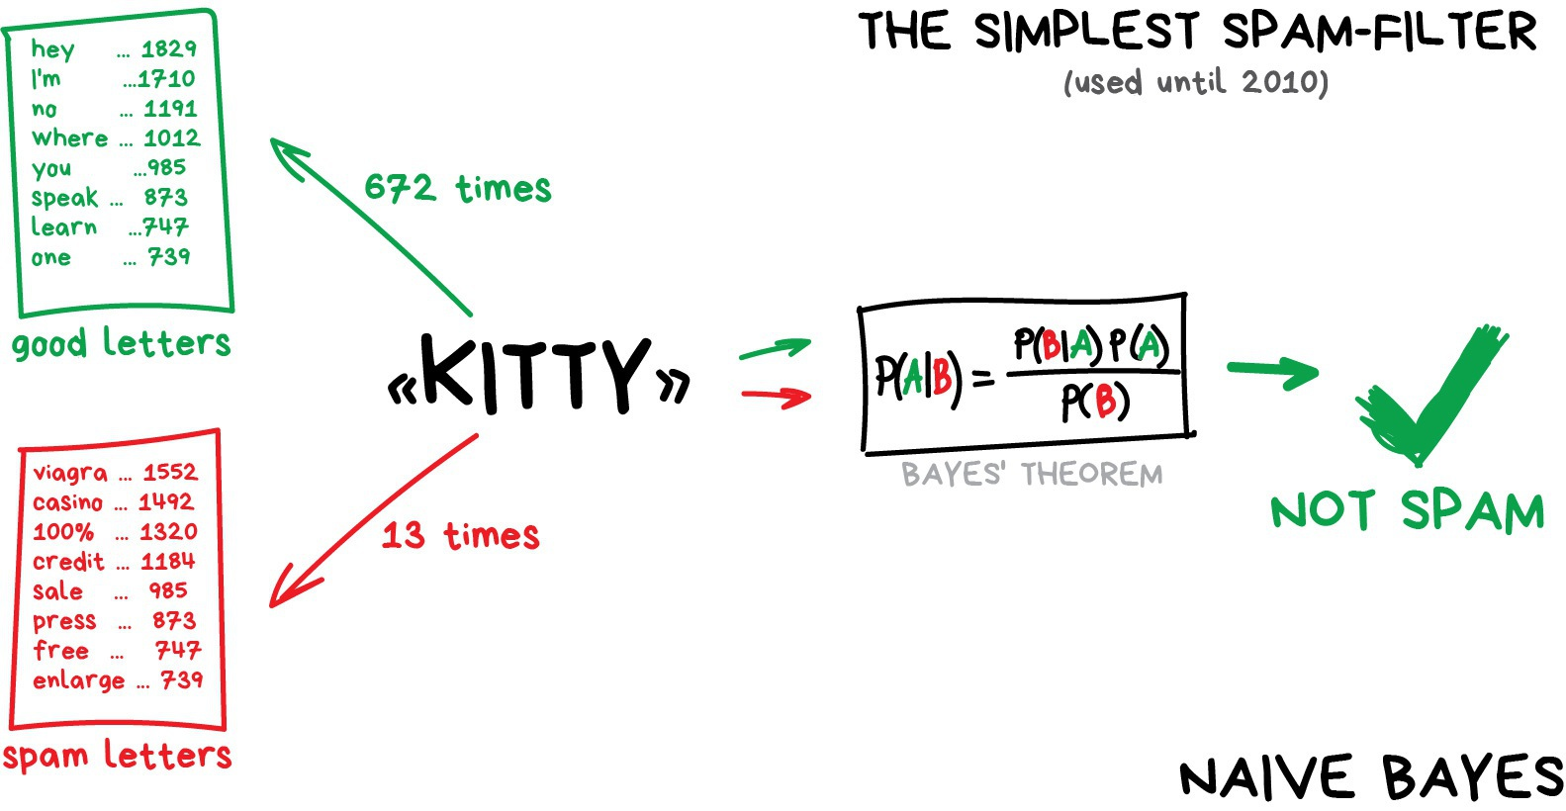
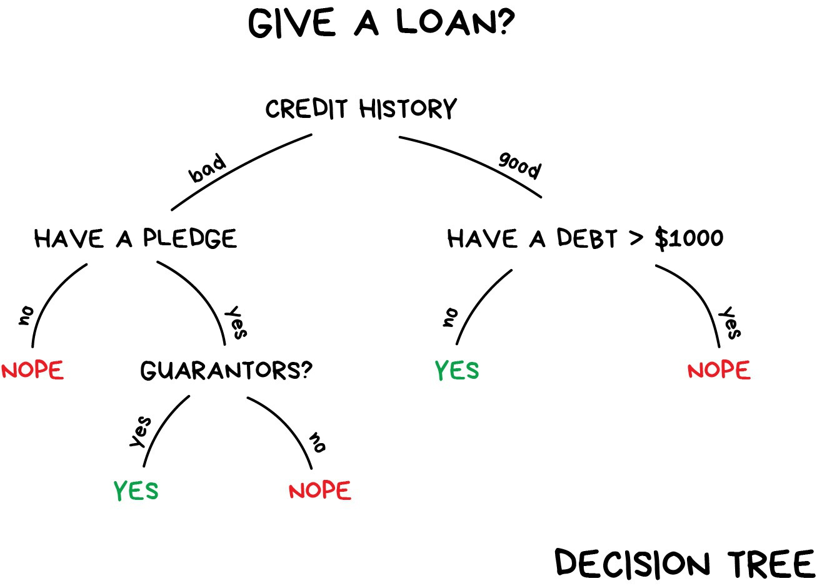
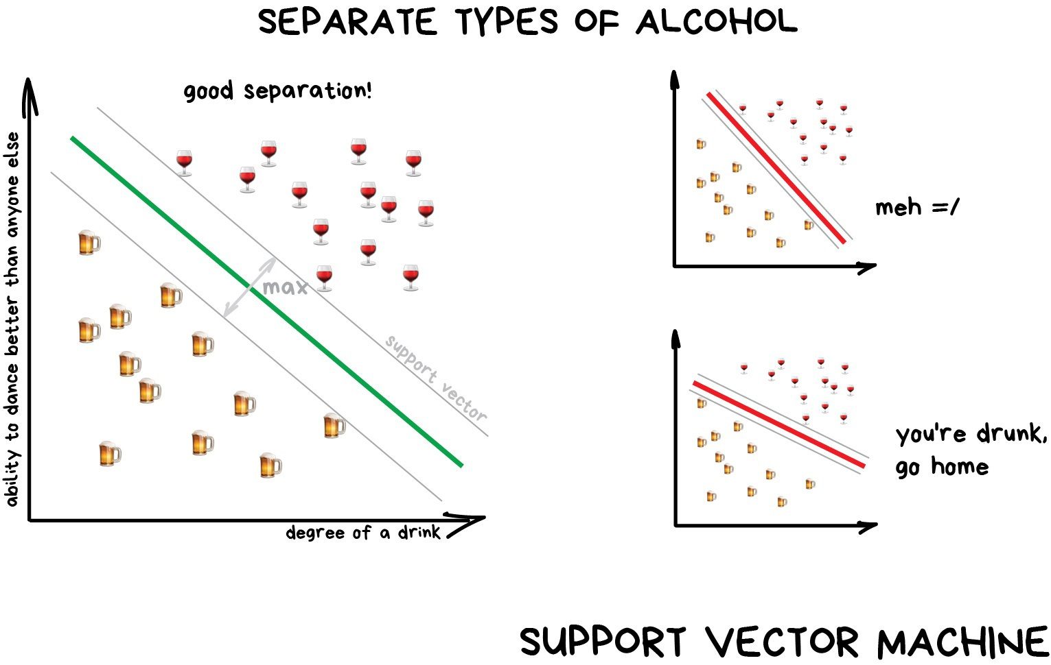
Supervised Learning - Classification
Splits objects based at one of the attributes known beforehand

Slide 5

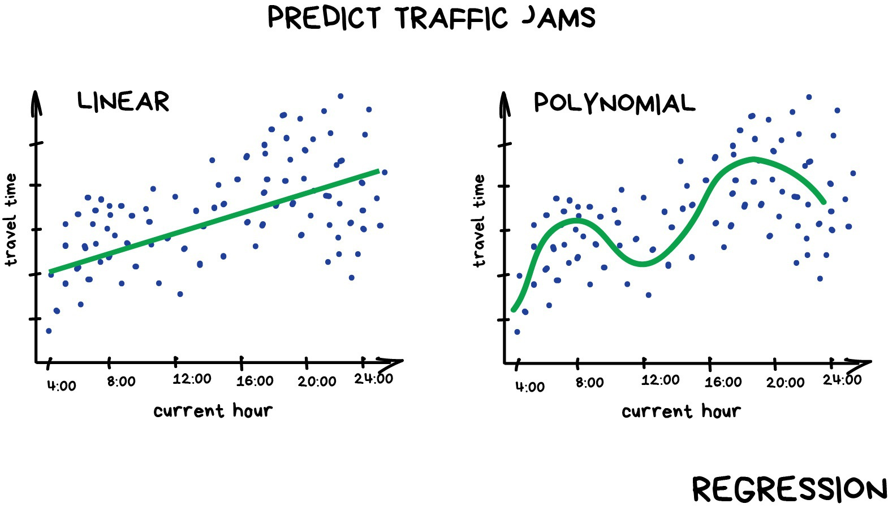
Supervised Learning - Regression
Regression is basically classification where we forecast a number instead of category

Slide 6
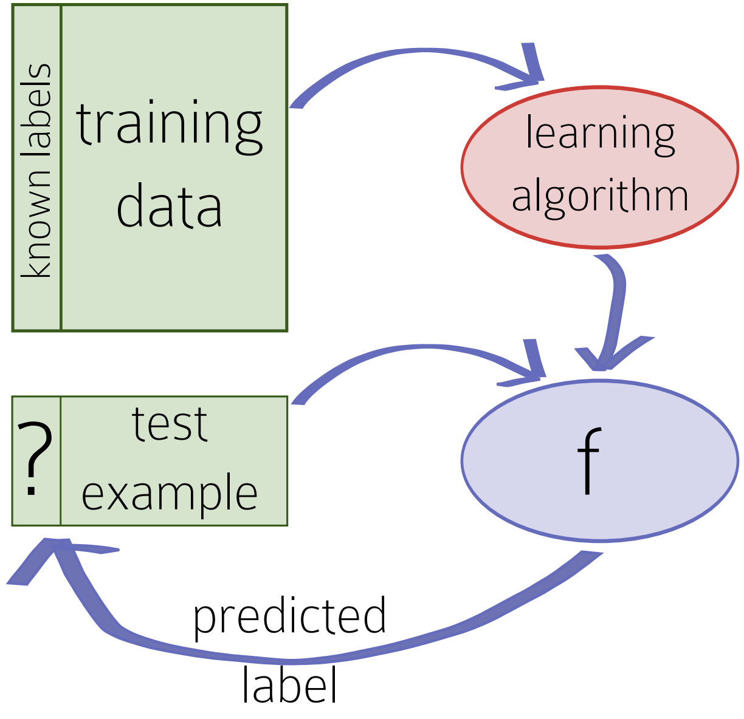
Supervised approach to Machine Learning

Slide 7
Classification: Decision Trees

Slide 8
Introduction
Classic and natural model of learning
Based on fundamental computer science notion of “divide and conquer”
It creates a model that predicts the value of a target variable based on several input variables
A tree can be learned by splitting the source set into subsets based on an attribute value test using recursive partitioning
The recursion is completed when the subset at a node has all the same value of the target variable, or when splitting no longer adds value to the predictions.
Although decision trees can be applied to many learning problems, we will begin with the simplest case: binary classification

Slide 9
The decision tree model of learning
Do people like movies of Amitabachan?

Slide 10
The decision tree model of learning
Do people like movies of Amitabachan?
Q : Is the genre of movie is “Action”?
Yes
Q : Is the lead actor is Amitabachan?
Yes
Q : Has people liked previous Action movie of the Amitabachan?
Yes
People do like Action movies of Amitabachan

Slide 11
The decision tree model of learning
Do people like movies of Amitabachan?
Q : Is the genre of movie is “Comedy”?
Yes
Q : Is the lead actor is Amitabachan?
Yes
Q : Has people liked previous comedy movie of the Amitabachan?
No
People don’t like Comedy movies of Amitabachan

Slide 12
The decision tree model of learning
Goal of learner: Figure out what questions to ask, and in what order, and what to predict when you have answered enough questions

Slide 13
The decision tree model of learning
Lead Actor | Genre | Hit(Y/N)
Amitabh Bacchan | Action | Yes
Amitabh Bacchan | Fiction | Yes
Amitabh Bacchan | Romance | No
Amitabh Bacchan | Action | Yes
Abhishek Bacchan | Action | No
Abhishek Bacchan | Fiction | No
Abhishek Bacchan | Romance | Yes

Slide 14
The decision tree model of learning
Lead Actor | Genre | Hit(Y/N)
Amitabh Bacchan | Action | Yes
Amitabh Bacchan | Fiction | Yes
Amitabh Bacchan | Romance | No
Amitabh Bacchan | Action | Yes
Abhishek Bacchan | Action | No
Abhishek Bacchan | Fiction | No
Abhishek Bacchan | Romance | Yes
Questions are features
Responses are feature values
Decision is the label

Slide 15
Why it’s Decision Tree?
Lead Actor | Genre | Hit(Y/N)
Amitabh Bacchan | Action | Yes
Amitabh Bacchan | Fiction | Yes
Amitabh Bacchan | Romance | No
Amitabh Bacchan | Action | Yes
Abhishek Bacchan | Action | No
Abhishek Bacchan | Fiction | No
Abhishek Bacchan | Romance | Yes

Slide 16
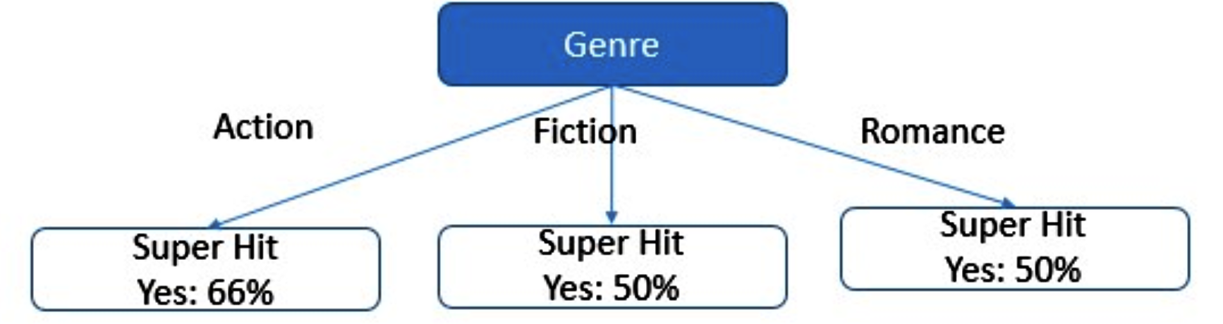
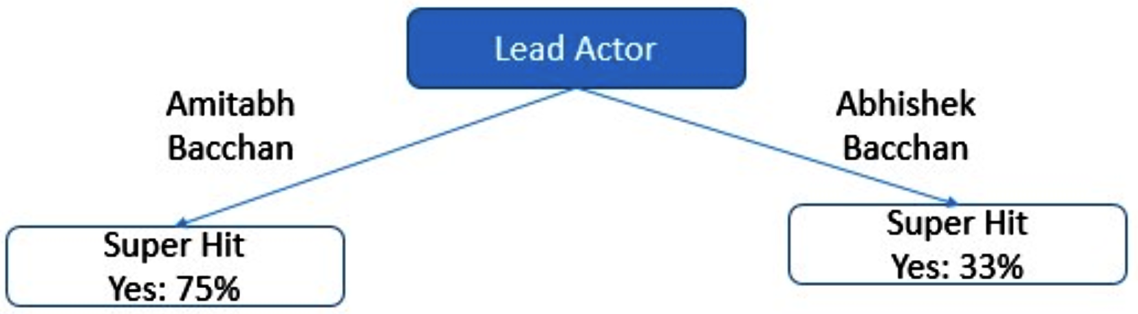
Why it’s Decision Tree?
Lead Actor | Genre | Hit(Y/N)
Amitabh Bacchan | Action | Yes
Amitabh Bacchan | Fiction | Yes
Amitabh Bacchan | Romance | No
Amitabh Bacchan | Action | Yes
Abhishek Bacchan | Action | No
Abhishek Bacchan | Fiction | No
Abhishek Bacchan | Romance | Yes
We can represent set of questions and guesses in a tree format

Slide 17
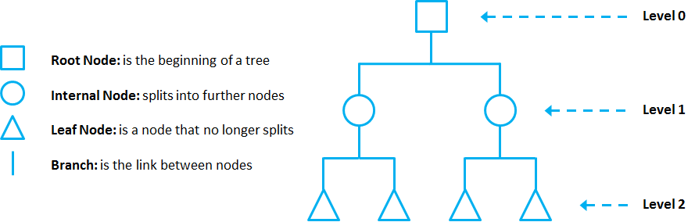
Terminologies

Slide 18
End of Session 1

Slide 19
Classification—A Two-Step Process
Model construction: describing a set of predetermined classes
Each tuple/sample is assumed to belong to a predefined class, as determined by the class label attribute
The set of tuples used for model construction is training set
The model is represented as classification rules, decision trees, or mathematical formulae
Model usage: for classifying future or unknown objects
Estimate accuracy of the model
The known label of test sample is compared with the classified result from the model
Accuracy rate is the percentage of test set samples that are correctly classified by the model
Test set is independent of training set (otherwise overfitting)
If the accuracy is acceptable, use the model to classify new data
Note: If the test set is used to select models, it is called validation (test) set

Slide 20
Illustrating Classification Task

Slide 21

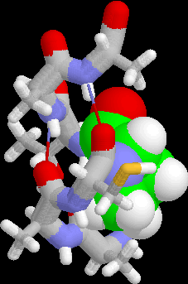
Examples of Classification Task
Predicting tumor cells as benign or malignant
Classifying credit card transactions as legitimate or fraudulent
Classifying secondary structures of protein as alpha-helix, beta-sheet, or random coil
Categorizing news stories as finance, weather, entertainment, sports, etc

Slide 22
Example of a Decision Tree
categorical
categorical
continuous
class
Splitting Attributes
Refund
Yes
No
NO
MarSt
Single, Divorced
Married
TaxInc
NO
< 80K
> 80K
NO
YES
Training Data
Model: Decision Tree

Slide 23
Another Example of Decision Tree
categorical
categorical
continuous
class
MarSt
Single, Divorced
Married
NO
Refund
Yes
No
NO
TaxInc
< 80K
> 80K
NO
YES
There could be more than one tree that fits the same data!

Slide 24
Decision Tree Classification Task
Decision Tree

Slide 25
Apply Model to Test Data
Test Data
Start from the root of tree.
Refund
Yes
No
NO
MarSt
Single, Divorced
Married
TaxInc
NO
< 80K
> 80K
NO
YES

Slide 26
Apply Model to Test Data
Test Data
Refund
Yes
No
NO
MarSt
Single, Divorced
Married
TaxInc
NO
< 80K
> 80K
NO
YES

Slide 27
Apply Model to Test Data
Test Data
Refund
Yes
No
NO
MarSt
Single, Divorced
Married
TaxInc
NO
< 80K
> 80K
NO
YES

Slide 28
Apply Model to Test Data
Test Data
Refund
Yes
No
NO
MarSt
Single, Divorced
Married
TaxInc
NO
< 80K
> 80K
NO
YES

Slide 29
Apply Model to Test Data
Test Data
Refund
Yes
No
NO
MarSt
Single, Divorced
Married
TaxInc
NO
< 80K
> 80K
NO
YES

Slide 30
Apply Model to Test Data
Test Data
Refund
Yes
No
NO
MarSt
Single, Divorced
Married
Assign Cheat to “No”
TaxInc
NO
< 80K
> 80K
NO
YES

Slide 31
Decision Tree Classification Task
Decision Tree

Slide 32
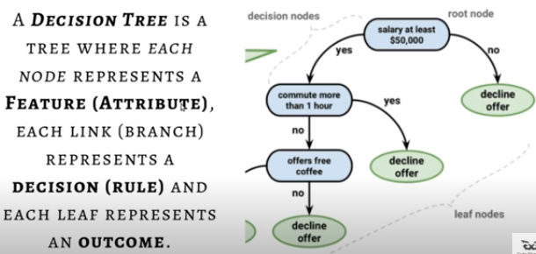
Decision Tree

Slide 33
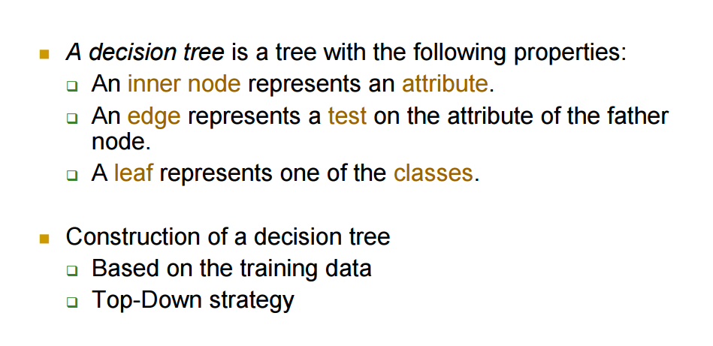
Decision Tree

Slide 34
Some DT algorithms
Hunt’s Algorithm (one of the earliest)
ID3 (Iterative Dichotomiser 3)
C4.5, 5.0
CART (Classification And Regression Trees)
CHAID (CHi-squared Automatic Interaction Detector)
MARS (Multivariate Adaptive Regression Splines)
Conditional Inference Trees

Slide 35
General Structure of Hunt’s Algorithm
Let D_{t} be the set of training records that reach a node t
General Procedure:
If D_{t} contains records that belong the same class y_{t}, then t is a leaf node labeled as y_{t}
If D_{t} is an empty set, then t is a leaf node labeled by the default class, y_{d}
If D_{t} contains records that belong to more than one class, use an attribute test to split the data into smaller subsets. Recursively apply the procedure to each subset.
This Splitting procedure is what can vary for different tree learning algorthims
D_{t}
?

Slide 36
Hunt’s Algorithm
Refund
Don’t
Cheat
Yes
No
Don’t
Cheat
Don’t
Cheat
Refund
Refund
Yes
No
Yes
No
Don’t
Cheat
Marital
Status
Don’t
Cheat
Marital
Status
Single,
Divorced
Married
Single,
Divorced
Married
Taxable
Income
Don’t
Cheat
Cheat
Don’t
Cheat
< 80K
>= 80K
Don’t
Cheat
Cheat

Slide 37
Tree Induction
Greedy strategy.
Split the records based on an attribute test that optimizes certain criterion.
Issues
Determine how to split the records
How to specify the attribute test condition?
How to determine the best split?
Determine when to stop splitting

Slide 38
Tree Induction
Greedy strategy.
Split the records based on an attribute test that optimizes certain criterion.
Issues
Determine how to split the records
How to specify the attribute test condition?
How to determine the best split?
Determine when to stop splitting

Slide 39
How to Specify Test Condition?
Depends on attribute types
Nominal
Ordinal
Continuous
Depends on number of ways to split
2-way split
Multi-way split

Slide 40
Splitting Based on Nominal Attributes
Multi-way split: Use as many partitions as distinct values.
Binary split: Divides values into two subsets. Need to find optimal partitioning.
CarType
Family
Luxury
Sports
CarType
OR
CarType
{Sports, Luxury}
{Family, Luxury}
{Family}
{Sports}

Slide 41
Splitting Based on Ordinal Attributes
Multi-way split: Use as many partitions as distinct values.
Binary split: Divides values into two subsets. Need to find optimal partitioning.
What about this split?
Size
Small
Large
Medium
Size
Size
{Small, Medium}
OR
{Medium, Large}
{Large}
{Small}
Size
{Small, Large}
{Medium}

Slide 42
Splitting Based on Continuous Attributes
Different ways of handling
Discretization to form an ordinal categorical attribute
Static – discretize once at the beginning
Dynamic – ranges can be found by equal interval bucketing, equal frequency bucketing (percentiles), or clustering.
Binary Decision: (A < v) or (A ≥ v)
consider all possible splits and finds the best cut
can be more compute intensive

Slide 43
Splitting Based on Continuous Attributes

Slide 44
Tree Induction
Greedy strategy.
Split the records based on an attribute test that optimizes certain criterion.
Issues
Determine how to split the records
How to specify the attribute test condition?
How to determine the best split?
Determine when to stop splitting

Slide 45
How to determine the Best Split
Before Splitting: 10 records of class 0, 10 records of class 1
Which test condition is the best?

Slide 46
How to determine the Best Split
Greedy approach:
Nodes with homogeneous class distribution are preferred
Need a measure of node impurity:
Non-homogeneous,
High degree of impurity
Homogeneous,
Low degree of impurity

Slide 47
Measures of Node Impurity
Entropy
Gini Index
Misclassification error

Slide 48
Stopping Criteria for Tree Induction
Stop expanding a node when all the records belong to the same class
Stop expanding a node when all the records have similar attribute values

Slide 49
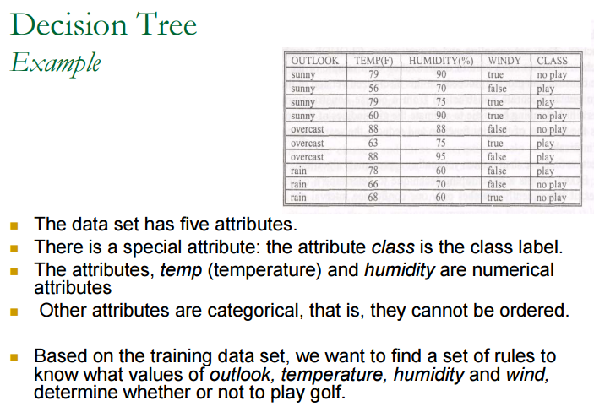

Slide 50
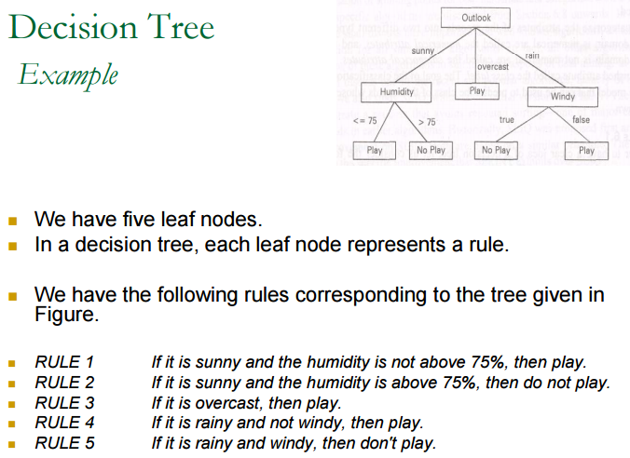

Slide 51
DT by Variable Type
Single Variable Decision Trees
Classifications are done with asking questions over only one variable
Hybrid Decision Trees
Classifications are done with asking questions over both single and multiple variables
Multiple Variables Decision Trees
Classifications are done with asking questions over multiple variables

Slide 52
ID3
• Developed by J. Ross Quinlan in 1979
Quinlan was a computer science researcher in data mining, and decision theory.
Received doctorate in computer science at the University of Washington in 1968.
• Based on Entropy
• Only works for discrete data
• Can not work with defective data
Advantage over Hunt's algorithm is choosing the right attribute while classification. (Hunt's algorithm chooses randomly)

Slide 53
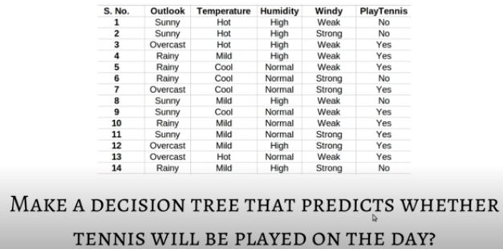
Decision Tree-Example

Slide 54
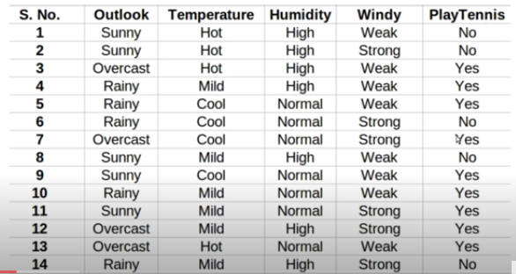
Contd…

Slide 55
Attribute Selection Measure: Information Gain (ID3) – Impurity Measure Entropy
Select the attribute with the highest information gain
Let p_{i} be the probability that an arbitrary tuple in D belongs to class C_{i}, estimated by |C_{i, D}|/|D|
Expected information (entropy) needed to classify a tuple in D:
Information needed (after using A to split D into v partitions) to classify D:
Information gained by branching on attribute A
Notes:
I : the expected information needed to classify a given sample
E (entropy) : expected information based on the partitioning into subsets by A

Slide 56
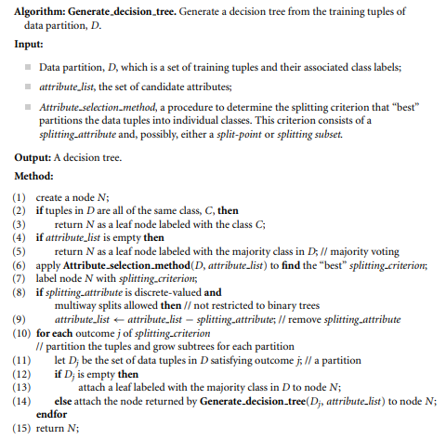
Decision Tree Algorithm

Slide 57
Algorithm for Decision Tree Induction
Basic algorithm (a greedy algorithm)
Tree is constructed in a top-down recursive divide-and-conquer manner
At start, all the training examples are at the root
Attributes are categorical (if continuous-valued, they are discretized in advance)
Examples are partitioned recursively based on selected attributes
Test attributes are selected on the basis of a heuristic or statistical measure (e.g., information gain)
Conditions for stopping partitioning
All samples for a given node belong to the same class
There are no remaining attributes for further partitioning – majority voting is employed for classifying the leaf
There are no samples left

Slide 58
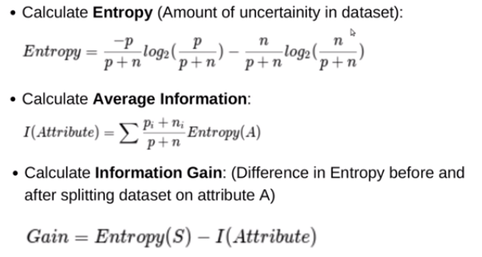
Contd…

Slide 59
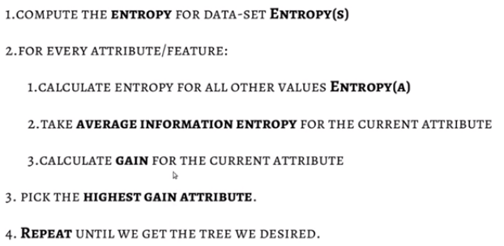
Process

Slide 60
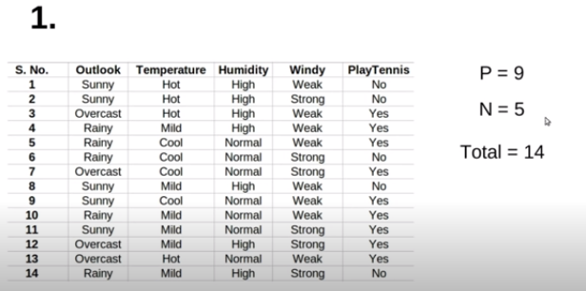
Contd…

Slide 61
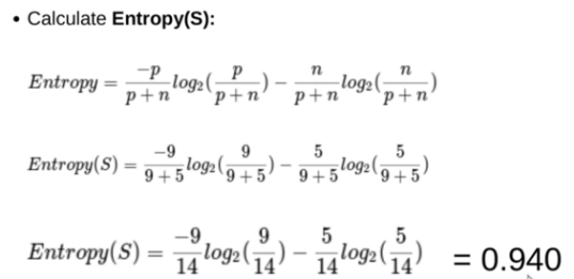
Contd…

Slide 62
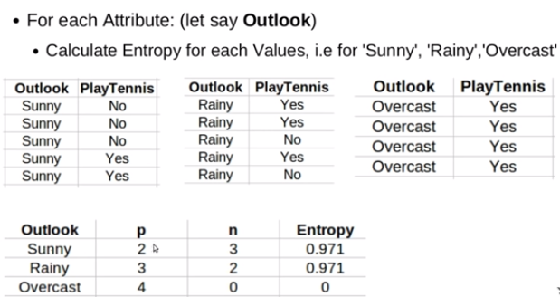
Contd…

Slide 63
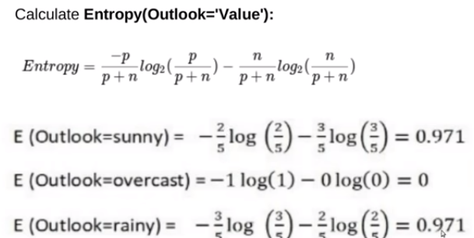
Contd…

Slide 64
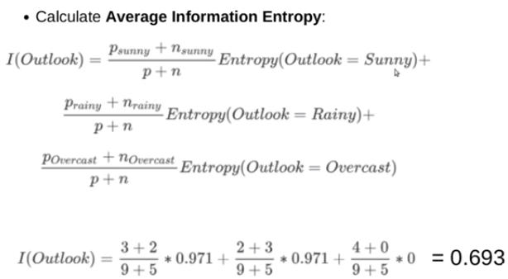
Contd…

Slide 65
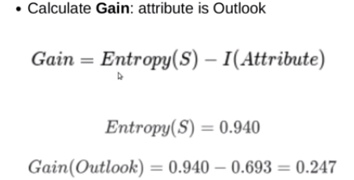
Contd…

Slide 66
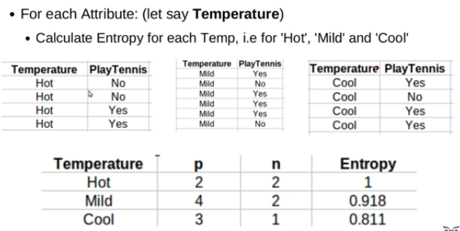
Contd…

Slide 67
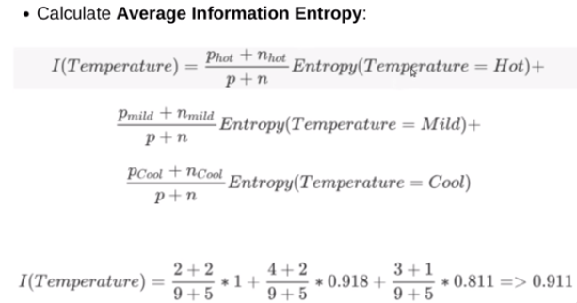
Contd…

Slide 68
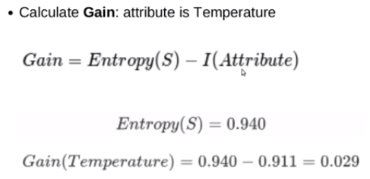
Contd…

Slide 69
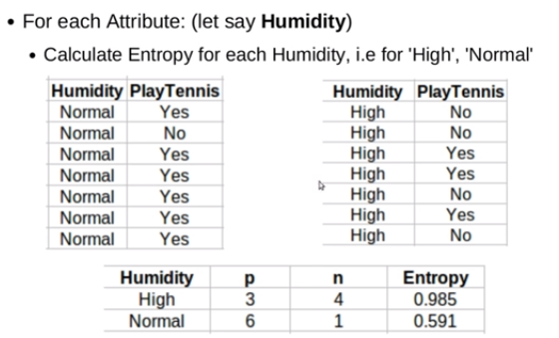
Contd…

Slide 70
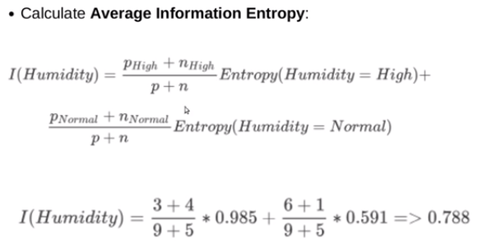
Contd…

Slide 71
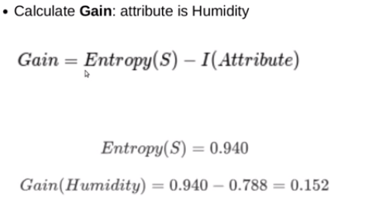
Contd…

Slide 72
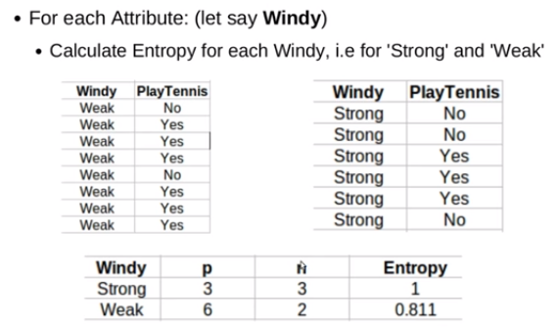
Contd…

Slide 73
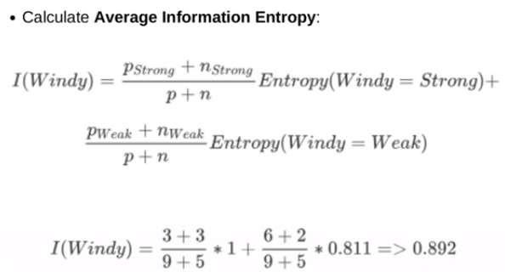
Contd…

Slide 74
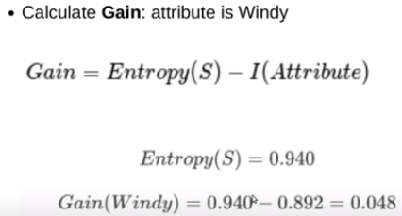
Contd…

Slide 75
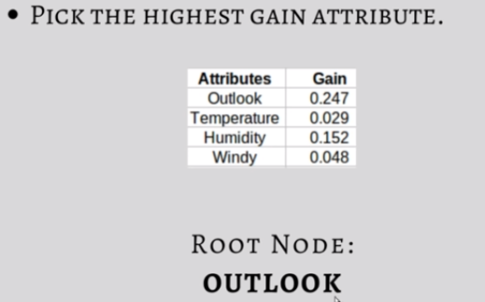
Contd…

Slide 76
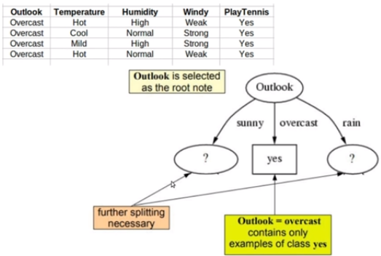
Contd…

Slide 77
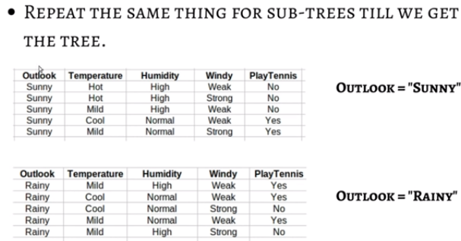
Contd…

Slide 78
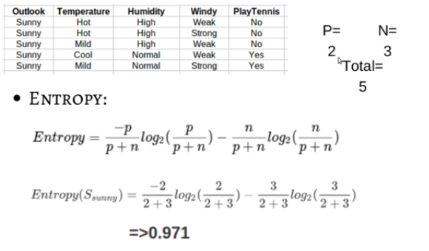
Contd…

Slide 79
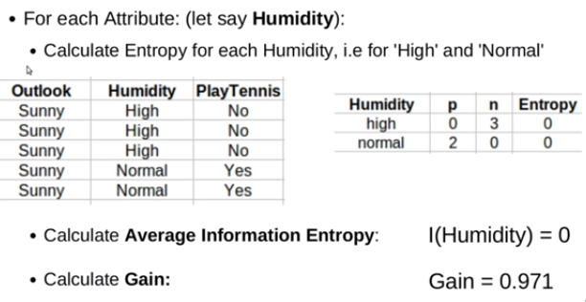
Contd…

Slide 80
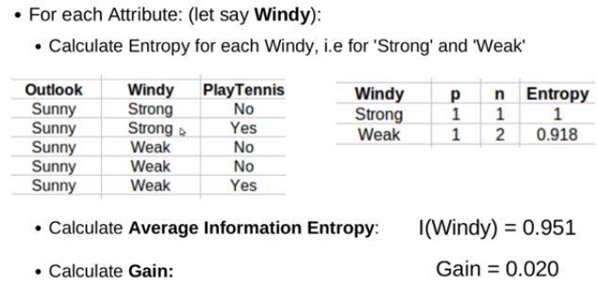
Contd…

Slide 81
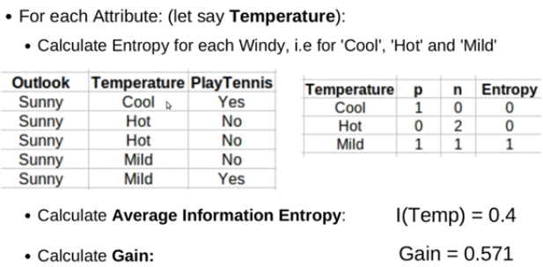
Contd…

Slide 82
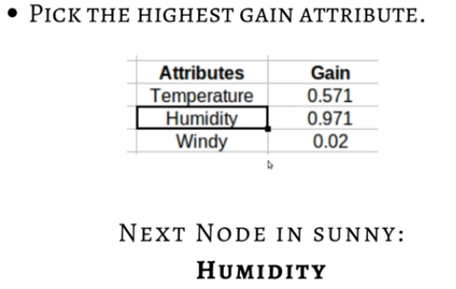
Contd…

Slide 83
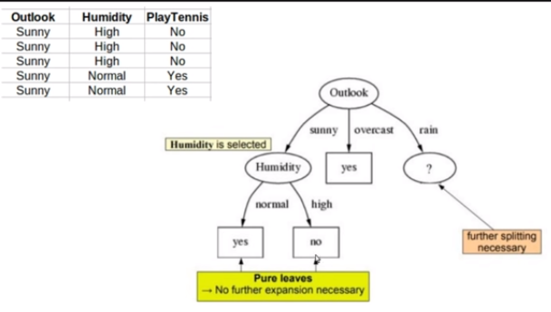
Contd…

Slide 84
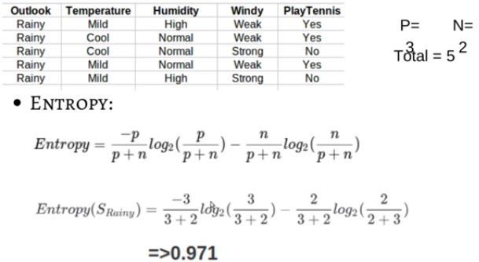
Contd…

Slide 85
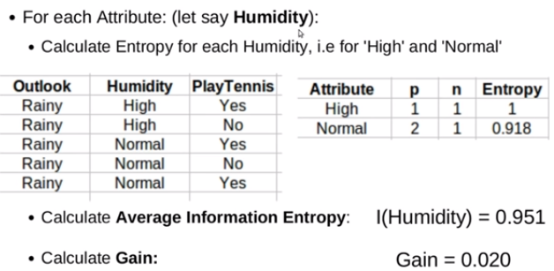
Contd…

Slide 86
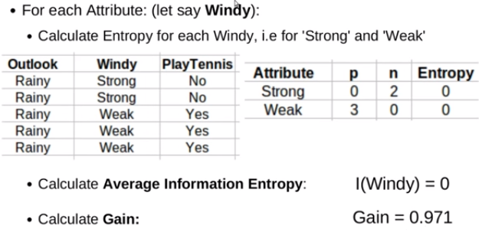
Contd…

Slide 87
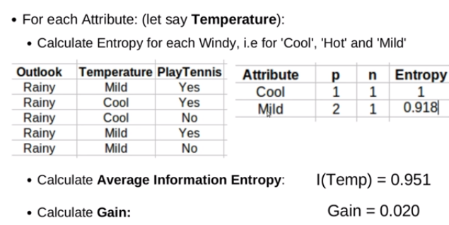
Contd…

Slide 88
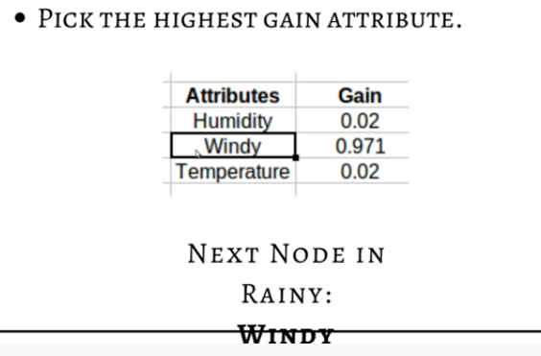
Contd…

Slide 89
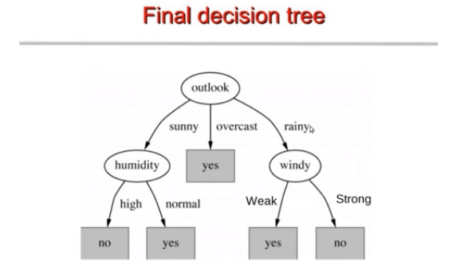
Contd…

Slide 90

Example 2

Slide 91
Computing Information-Gain for Continuous-Valued Attributes
Let attribute A be a continuous-valued attribute
Must determine the best split point for A
Sort the value A in increasing order
Typically, the midpoint between each pair of adjacent values is considered as a possible split point
(a_{i}+a_{i+1})/2 is the midpoint between the values of a_{i} and a_{i+1}
The point with the minimum expected information requirement for A is selected as the split-point for A
Split:
D1 is the set of tuples in D satisfying A ≤ split-point, and D2 is the set of tuples in D satisfying A > split-point

Slide 92

Example 3

Slide 93

Example 4

Slide 94
Example 5
Lead Actor | Genre | Hit(Y/N)
Amitabh Bacchan | Action | Yes
Amitabh Bacchan | Fiction | Yes
Amitabh Bacchan | Romance | No
Amitabh Bacchan | Action | Yes
Abhishek Bacchan | Action | No
Abhishek Bacchan | Fiction | No
Abhishek Bacchan | Romance | Yes

Slide 95
Pros of ID3 Algorithm
Builds decision tree in minimum steps
Each level benefits from previous level choices
Whole dataset is scanned to create tree

Slide 96
Cons of ID3 Algorithm
Tree can not be updated when new data is classified incorrectly, instead a new tree must be generated.
Only one attribute at a time is tested for making a decision.
Can not work with defective data
Can not work with numerical attributes

Slide 97

Decision Tree Boundary

Slide 98

Decision Tree Boundary

Slide 99
End of Session 2

